Slide 1
COMPUTER GRAPHICS PROJECT REPORT ON 3D VIEW OF SHANTI STUPA
Submitted by:
1. Prakash dhakal (pul074bex423)
2. raj Adhikari (pul074bex433)
3. sunney sharma (pul074bex449)
4. Shashank subedi (pul074bex450)

Slide 2
Objectives:
To design the 3D model of Shanti stupa of Pokhara.
To implement the features of computer graphics learnt into the project.
To implement the 3D rotational, scaling effects.
To implement the color filling and lightning effects

Slide 3
Methodology:
Visual Studio and C++ language (Opengl) was used.
Perspective 2D projection from 3D model.
Z-buffer was attempted for VSD.
Phong’s Illumination model was used for lighting.

Slide 4
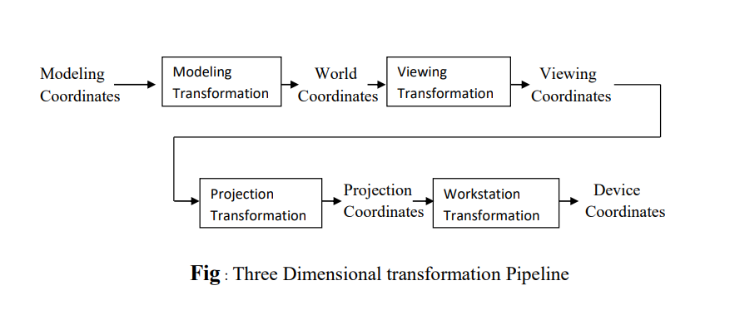
Viewing pipeline:

Slide 5
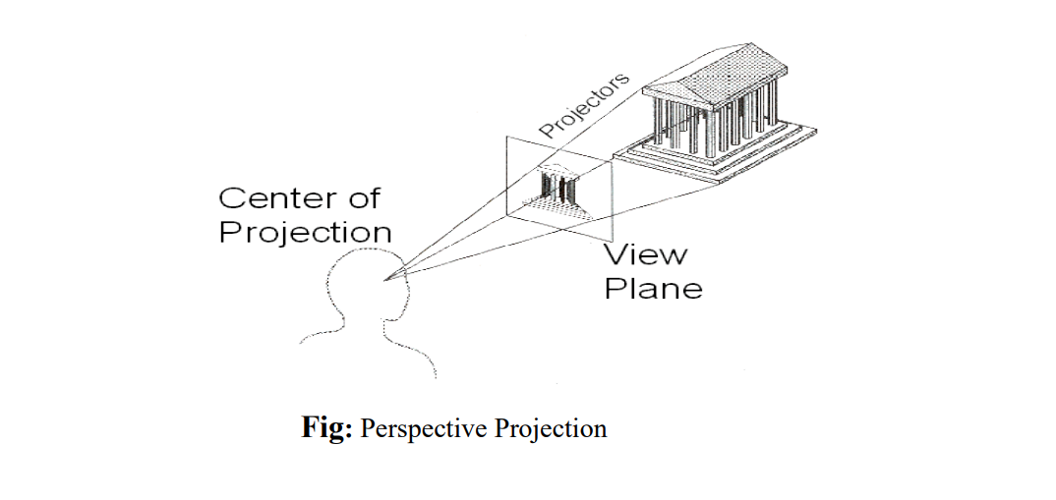
Perspective Projection:

Slide 6
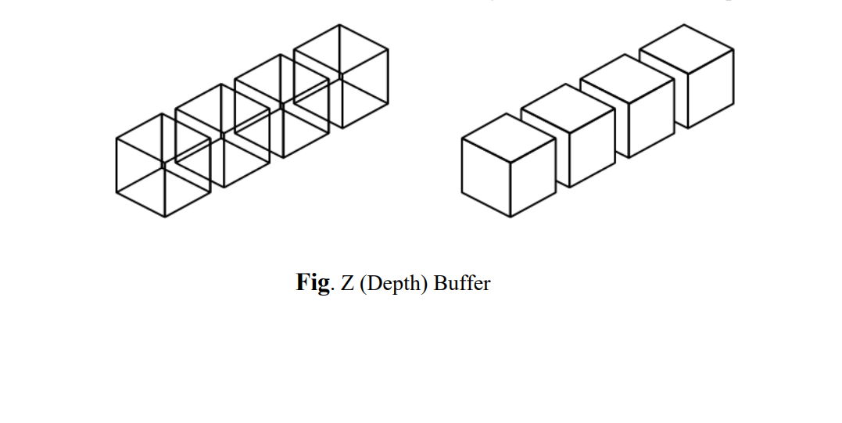
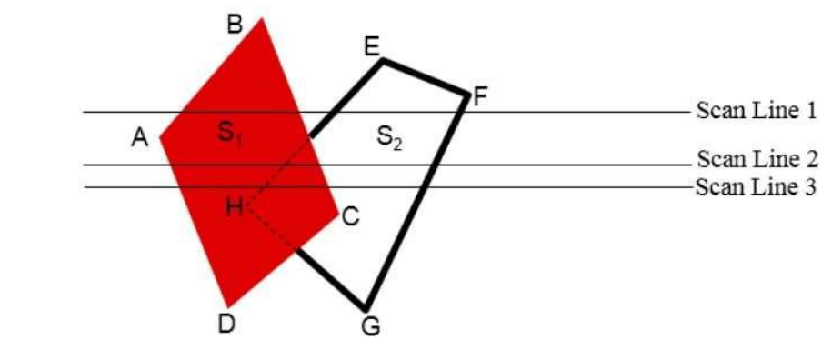
Z-Buffer and Scan-Line Method:

Slide 7
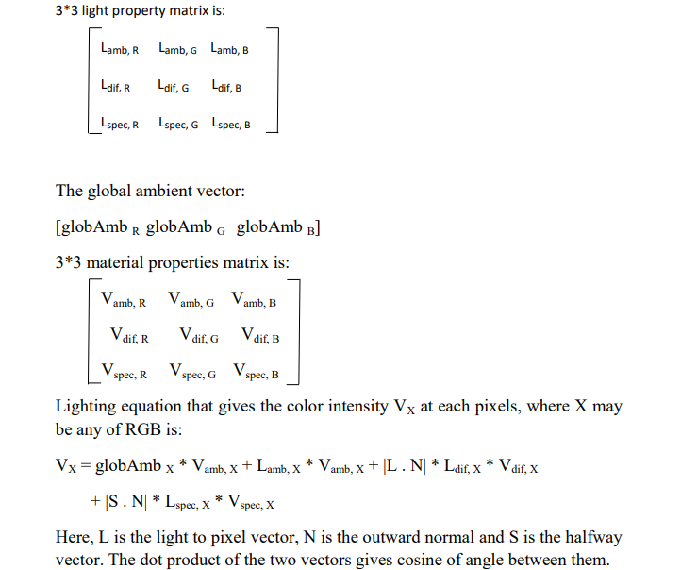
Phong Shading:

Slide 8
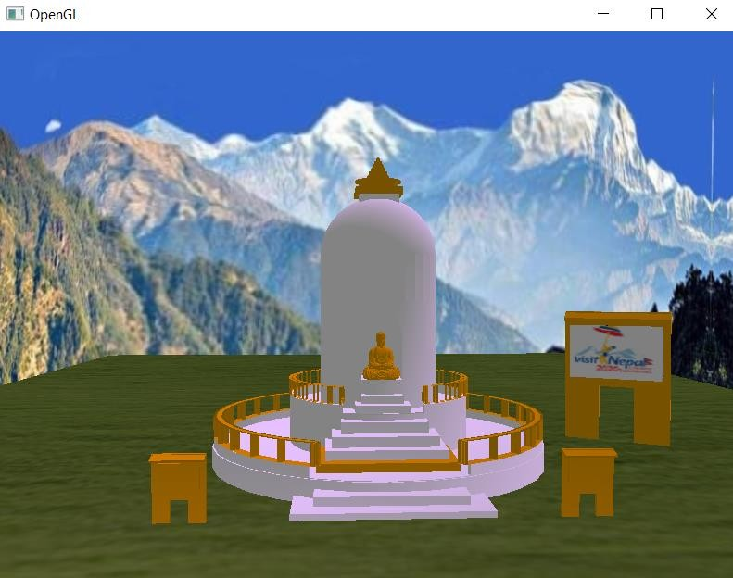
Output:

Slide 9

Thank you for your time.

